Slide 1

Machine Learning Case Studies
P. Boily | UNIVERSITY OF OTTAWA | FACULTY OF SCIENCE | DEPARTMENT OF MATHEMATICS AND STATISTICS DATA ACTION LAB | IDLEWYLD ANALYTICS

Slide 2
Association Rules Mining Case Study
Objective
Using data from the Danish National Patient Registry, the authors sought connections between different diagnoses: how does a diagnosis at some point in time allow for the prediction of another diagnosis at a later time?
Danish Medical Data
Jensen et al. Temporal disease trajectories condensed from population-wide registry data covering 6.2 million patients Nature Communications, vol. 5, 2014

Slide 3
Association Rules Mining Case Study
Methodology
compute the strength of correlation for pairs of diagnoses over a 5 year interval (on a representative subset of the data)
test diagnoses pairs for directionality (one diagnosis repeatedly occurring before the other)
determine reasonable diagnosis trajectories (thoroughfares) by combining smaller (but frequent) trajectories with overlapping diagnoses
validate the trajectories by comparison with non-Danish data
cluster the thoroughfares to identify a small number of central medical conditions (key diagnoses) around which disease progression is organized
Danish Medical Data
Jensen et al. Temporal disease trajectories condensed from population-wide registry data covering 6.2 million patients Nature Communications, vol. 5, 2014

Slide 4
Association Rules Mining Case Study
Data
The Danish National Patient Registry is an electronic health registry containing administra-tive information and diagnoses, covering the whole population of Denmark, including private and public hospital visits of all types:
inpatient (overnight stay)
outpatient (no overnight stay)
emergency visits.
The data set covers 15 years of such visits, from January ’96 to November ’10, and consists of 68 million records for 6.2 million patients.
Danish Medical Data
Jensen et al. Temporal disease trajectories condensed from population-wide registry data covering 6.2 million patients Nature Communications, vol. 5, 2014

Slide 5
Association Rules Mining Case Study
Challenges and Pitfalls
Access to the patient registry was protected and could only be granted after approval by the National Board of Health.
There are gender-specific differences in diagnostic trends, but many diagnoses were made predominantly in different sites, suggesting the stratifying by site as well as by gender.
In the process of forming small diagnoses chains, they had to compute the correlations using large groups for each pair of diagnoses (1 million diagnosis pairs = 80+ million samples) to compensate for multiple testing (1000s years’ worth of CPU run time) – pre-filtering steps were used to avoid this pitfall.
Danish Medical Data
Jensen et al. Temporal disease trajectories condensed from population-wide registry data covering 6.2 million patients Nature Communications, vol. 5, 2014

Slide 6
Association Rules Mining Case Study
Project Summary and Results
The dataset was reduced to 1,171 significant trajectories.
These thoroughfares were clustered into patterns centred on 5 key diagnoses for disease progression:
diabetes
chronic obstructive pulmonary disease (COPD)
cancer
arthritis
cerebrovascular disease
Danish Medical Data
Jensen et al. Temporal disease trajectories condensed from population-wide registry data covering 6.2 million patients Nature Communications, vol. 5, 2014

Slide 7
Association Rules Mining Case Study
Project Summary and Results
Early diagnoses for these central factors can help reduce the risk of adverse outcome linked to future diagnoses of other conditions.
Among the specific results, the following “surprising” insights were found:
a diagnosis of anemia is typically followed months later by the discovery of colon cancer
a diagnosis of gout was identified as a step on the path toward eventual diagnosis of cardiovascular diseases
COPD is under-diagnosed and under-treated
Danish Medical Data
Jensen et al. Temporal disease trajectories condensed from population-wide registry data covering 6.2 million patients Nature Communications, vol. 5, 2014

Slide 8
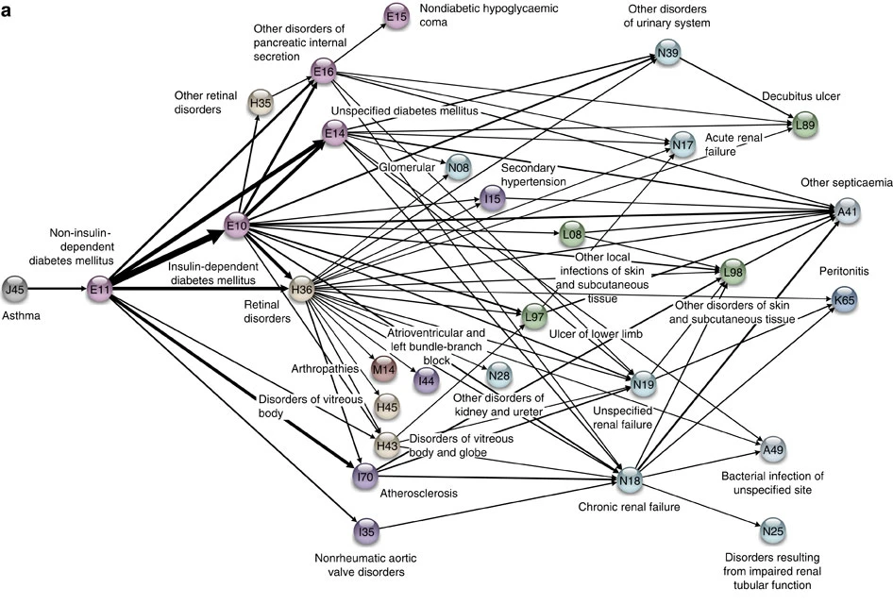
Association Rules Mining Case Study
Danish Medical Data
Jensen et al. Temporal disease trajectories condensed from population-wide registry data covering 6.2 million patients Nature Communications, vol. 5, 2014

Slide 9
Classification Case Study
Objective
The U.S. Internal Revenue Service (IRS) estimated that there were large gaps between revenue owed and revenue collected for 2001 and for 2006.
Using DoR data, the authors sought to increase efficiency in the audit selection process and to reduce the gap between revenue owed and revenue collected.
Minnesota Tax Audits
Hsu et al. Data Mining Based Tax Audit Selection: A Case Study of a Pilot Project at the Minnesota Department of Revenue Real World Data Mining Applications, 2015

Slide 10
Classification Case Study
Methodology
data selection and separation: experts selected several hundred cases to audit and divided them into training, testing and validating sets
classification modeling using MultiBoosting, Naïve Bayes, C4.5 decision trees, multilayer perceptrons, support vector machines, etc.
evaluation of all models on the testing set – models performed poorly until the size of the business being audited was recognized to have an effect, leading to two separate tasks (large/small businesses).
model selection/validation compared the estimated accuracy between different classification model predictions and the actual field audits (MultiBoosting with Naïve Bayes was selected as the final model; suggesting improvements to increase audit efficiency).
Minnesota Tax Audits
Hsu et al. Data Mining Based Tax Audit Selection: A Case Study of a Pilot Project at the Minnesota Department of Revenue Real World Data Mining Applications, 2015

Slide 11
Classification Case Study
Data
Selected tax audit cases from 2004 to 2007, collected by the audit experts, which were split into training, testing and validation sets:
the training data set consisted of Audit Plan General (APGEN) Use Tax audits and their results for the years 2004-2006
the testing data consisted of APGEN Use Tax audits conducted in 2007 and was used to test or evaluate models (for Large and Smaller businesses) built on the training dataset
while validation was assessed by actually conducting field audits on predictions made by models built on 2007 Use Tax return data processed in 2008.
Minnesota Tax Audits
Hsu et al. Data Mining Based Tax Audit Selection: A Case Study of a Pilot Project at the Minnesota Department of Revenue Real World Data Mining Applications, 2015

Slide 12
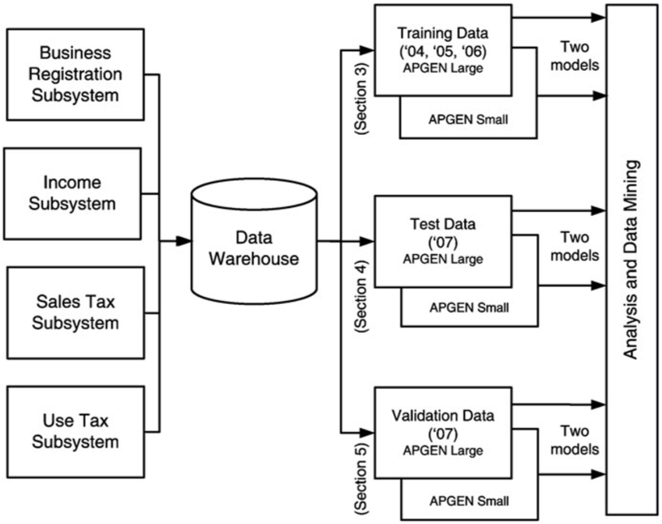
Classification Case Study
Minnesota Tax Audits
Hsu et al. Data Mining Based Tax Audit Selection: A Case Study of a Pilot Project at the Minnesota Department of Revenue Real World Data Mining Applications, 2015

Slide 13
Classification Case Study
Strengths and Limitations of the Algorithms
Naïve Bayes classification assumes independence of the features, which rarely occurs in real-world situations. This approach is also known to potentially introduce bias to classification schemes. In spite of this, classification models built using it have a successfully track record.
MultiBoosting is an ensemble technique that uses committee (i.e. groups of classification models) and “group wisdom” to make predictions; unlike other ensemble techniques, it is different from other ensemble techniques in the sense that it forms a committee of sub-committees, which has a tendency to reduce both bias and variance of predictions.
Minnesota Tax Audits
Hsu et al. Data Mining Based Tax Audit Selection: A Case Study of a Pilot Project at the Minnesota Department of Revenue Real World Data Mining Applications, 2015

Slide 14
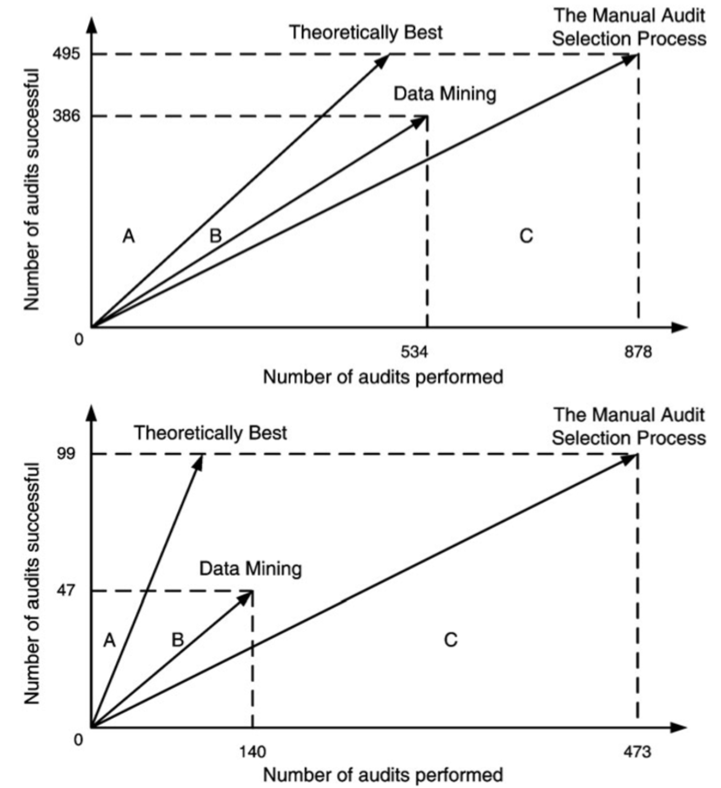
Classification Case Study
APGEN Large
Minnesota Tax Audits
Hsu et al. Data Mining Based Tax Audit Selection: A Case Study of a Pilot Project at the Minnesota Department of Revenue Real World Data Mining Applications, 2015
APGEN Small

Slide 15
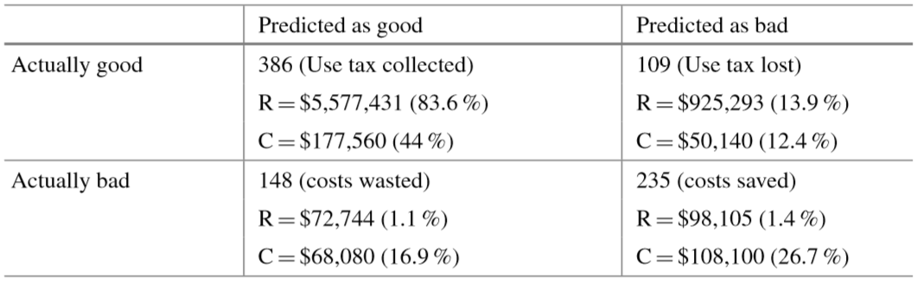
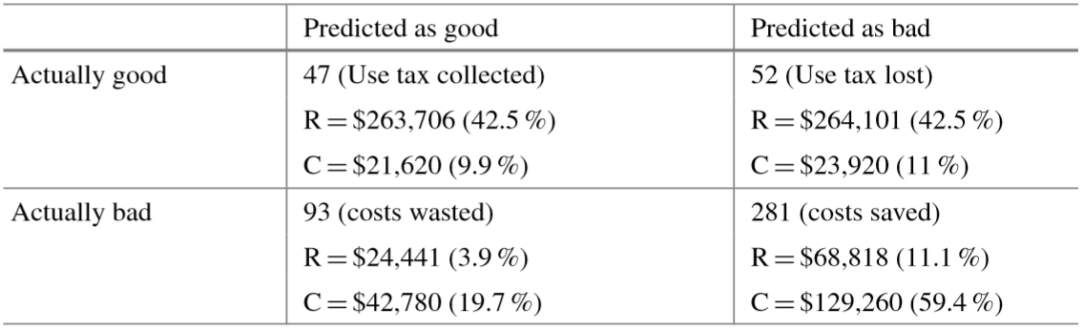
Classification Case Study
APGEN Large
Minnesota Tax Audits
Hsu et al. Data Mining Based Tax Audit Selection: A Case Study of a Pilot Project at the Minnesota Department of Revenue Real World Data Mining Applications, 2015
APGEN Small

Slide 16
Classification Case Study
Take-Aways
Many models were churned out before the team made a final selection.
Past performance of a model family in a previous project can guide the selection, but remember the No Free Lunch (NFL) Theorem: nothing works best all the time!
The feature selection process could very well require a number of visits to domain experts before the feature set yields promising results.
Data analysis teams should seek out individuals with a good understand of both data and context.
Domain-specific knowledge has to be integrated in the model in order to beat random classifiers, on average.
Even slight improvements over the current approach can find a useful place in an organization – data science is not solely about Big Data and disruption!
Minnesota Tax Audits
Hsu et al. Data Mining Based Tax Audit Selection: A Case Study of a Pilot Project at the Minnesota Department of Revenue Real World Data Mining Applications, 2015

Slide 17
Clustering Case Study
Objective
When we think of similarity at the urban level, we typically think in terms of neighbourhoods. Is there some other way to identify similar parts of a city?
The researchers aims to draw the boundaries of livehoods, areas of similar character within a city, by using clustering models. Unlike static administrative neighborhoods, the livehoods are defined based on the habits of their inhabitants.
Livehoods
Cranshaw et al. The Livehoods Project: Utilizing Social Media to Understand the Dynamics of a City ICWSM, 2012

Slide 18
Clustering Case Study
Methodology
The authors use spectral clustering to discover distinct geographic areas of the city based on collective movement patterns.
Livehood clusters are built as follows:
a geographic distance is computed based on pairs of check-in venues’ coordinates;
a social similarity is computed between each pair of venues using cosine measurements;
spectral clustering produces candidate livehoods;
interviews are conducted with residents in order to explore, label, and validate the clusters discovered by the algorithm.
Livehoods
Cranshaw et al. The Livehoods Project: Utilizing Social Media to Understand the Dynamics of a City ICWSM, 2012

Slide 19
Clustering Case Study
Data
The data comes from two sources, combining approximately 11 million check-ins from the dataset of Chen et al. (a recommendation site for venues based on users’ experiences) and a new dataset of 7 million Twitter check-ins downloaded between June and December of 2011.
For each check-in, the data consists of the user ID, the time, the latitude and longitude, the name of the venue, and its category.
In this case study, data from the city of Pittsburgh, Pennsylvania, is examined via 42,787 check-ins of 3840 users at 5349 venues.
Livehoods
Cranshaw et al. The Livehoods Project: Utilizing Social Media to Understand the Dynamics of a City ICWSM, 2012

Slide 20
Clustering Case Study
Strengths and Limitations of the Approach
The technique used in this study is agnostic towards the particular source of the data: it is not dependent on meta-knowledge about the data.
The algorithm may be prone to “majority” bias, possibly misrepresenting/hiding minority behaviours.
The dataset is built from a limited sample of check-ins shared on Twitter and are therefore biased towards the types of visits/locations that people typically want to share publicly.
Tuning the clusters is non-trivial: experimenter bias may combine with “confirmation bias” of the interviewees in the validation stage – if the researchers are residents of Pittsburgh, will they see clusters when there were none?
Livehoods
Cranshaw et al. The Livehoods Project: Utilizing Social Media to Understand the Dynamics of a City ICWSM, 2012

Slide 21
Clustering Case Study
Results, Evaluation, and Validation
Over 3 areas of the city, 9 livehoods have been identified and validated by 27 Pittsburgh residents
Municipal Neighborhoods Borders: livehoods are dynamic, and evolve as people’s behaviours change, unlike fixed neighbourhoods set by the city government.
Demographics: the interviews displayed strong evidence that the demographics of the residents and visitors of an area play a strong role in explaining the livehood divisions.
Development and Resources: economic development can affect the character of an area. Similarly, the resources provided by a region has a strong influence on the people that visit it, and hence its resulting character.
Livehoods
Cranshaw et al. The Livehoods Project: Utilizing Social Media to Understand the Dynamics of a City ICWSM, 2012

Slide 22
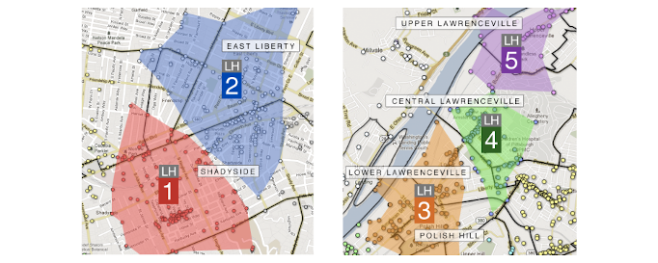
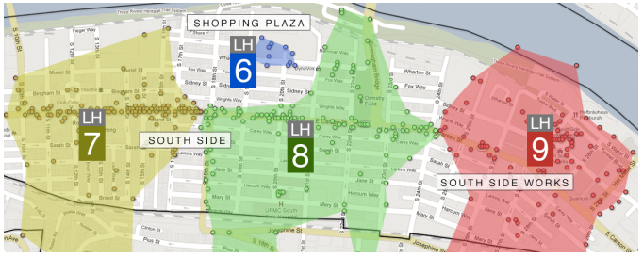
Clustering Case Study
Livehoods
Cranshaw et al. The Livehoods Project: Utilizing Social Media to Understand the Dynamics of a City ICWSM, 2012

Slide 23
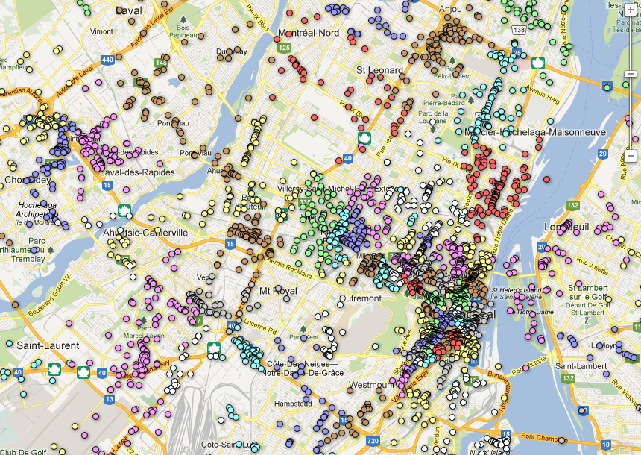
Clustering Case Study
Livehoods
Cranshaw et al. The Livehoods Project: Utilizing Social Media to Understand the Dynamics of a City ICWSM, 2012

